Slide 1
Design Thinking
Rare books - Phase 1

Slide 2
Empathize
Managers and Employees have been using the same Excel sheet and everyone has access to all functions.
Only was able to use the excel sheet from one location
Lack any security measure in the excel sheet
Similar to an excel sheet, the manager and employee want to be able to manipulate the book data in various way.

Slide 3
Define the Problem
Tracking:
Track each employee’s actions while on the application
Create a simple login page
Tracking deletion
Login:
Create a simple login page
Security Features:
Create an automatic and manual logout

Slide 4
Define the Problem
Homepage Layout:
Create page for employees and manager to see the inventory
Define the image, title, author, year, condition, quantity
Create a way for user to update and send delete request
Manager Layout:
Similar table layout to homepage
Create manager table to track the deletion requestion of employees
Add who make the request
Add NewBook Layout:
Create a way for the user to add new books

Slide 5
Ideate
Tracking/Login:
Make the login page its own page. No other info just for clarity
The username is taking from the user input and stored to local storage
password will not be stored
Security Features:
Can either logout out manually or automatically after 1 minute of inactivity
Timer appears on page when there is 15 seconds from the one-minute inactivity

Slide 6
Ideate
Homepage Layout:
Use a table to recreate the excel spreadsheet in the web app
Columns: image, title, author, year, condition, quantity
Who is logged in will be in the top left corner to identify is logged in
Search input box to search by title or author
Manager Layout:
Similar to homepage layout
Column additions: date submitted, date approved, and submitted by
An Approve/Deny button will be in the row with each book
Manager status will be determined in user object (manager: true)

Slide 7
ideate
Add Book Layout:
A form that have inputs for all the columns of the table
User will be able to enter input for all those columns

Slide 8
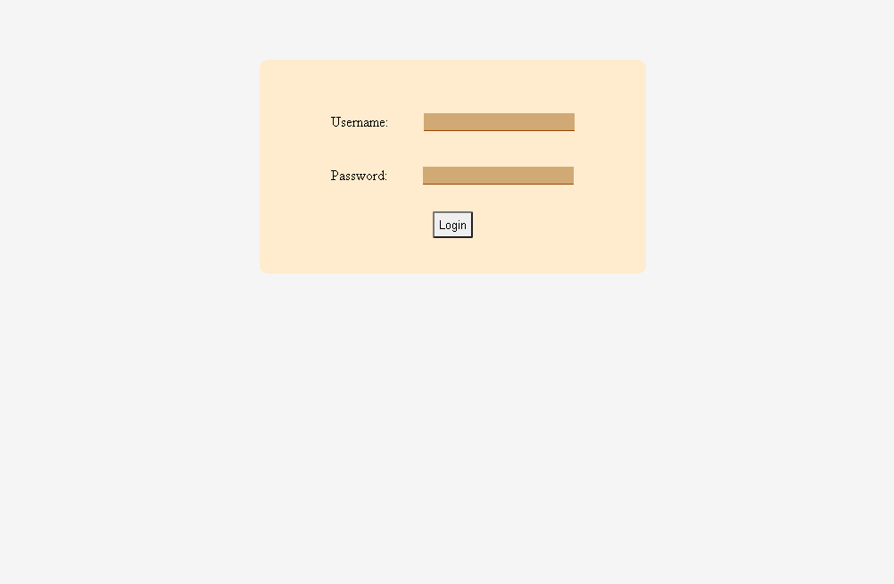
PROTOTYPE (login)

Slide 9
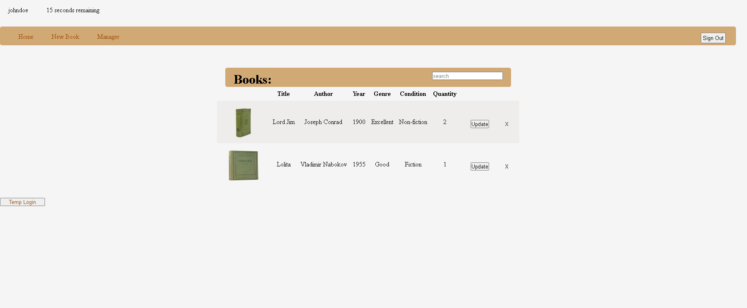
PROTOTYPE (home)

Slide 10
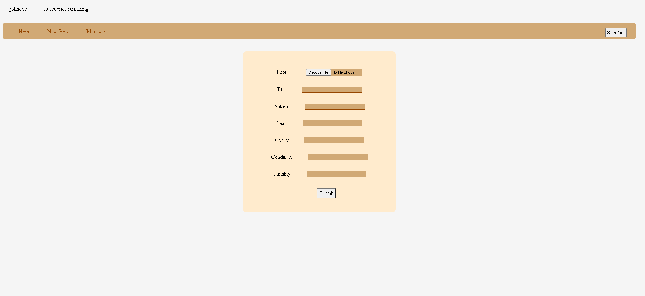
PROTOTYPE (Add new book)

Slide 11
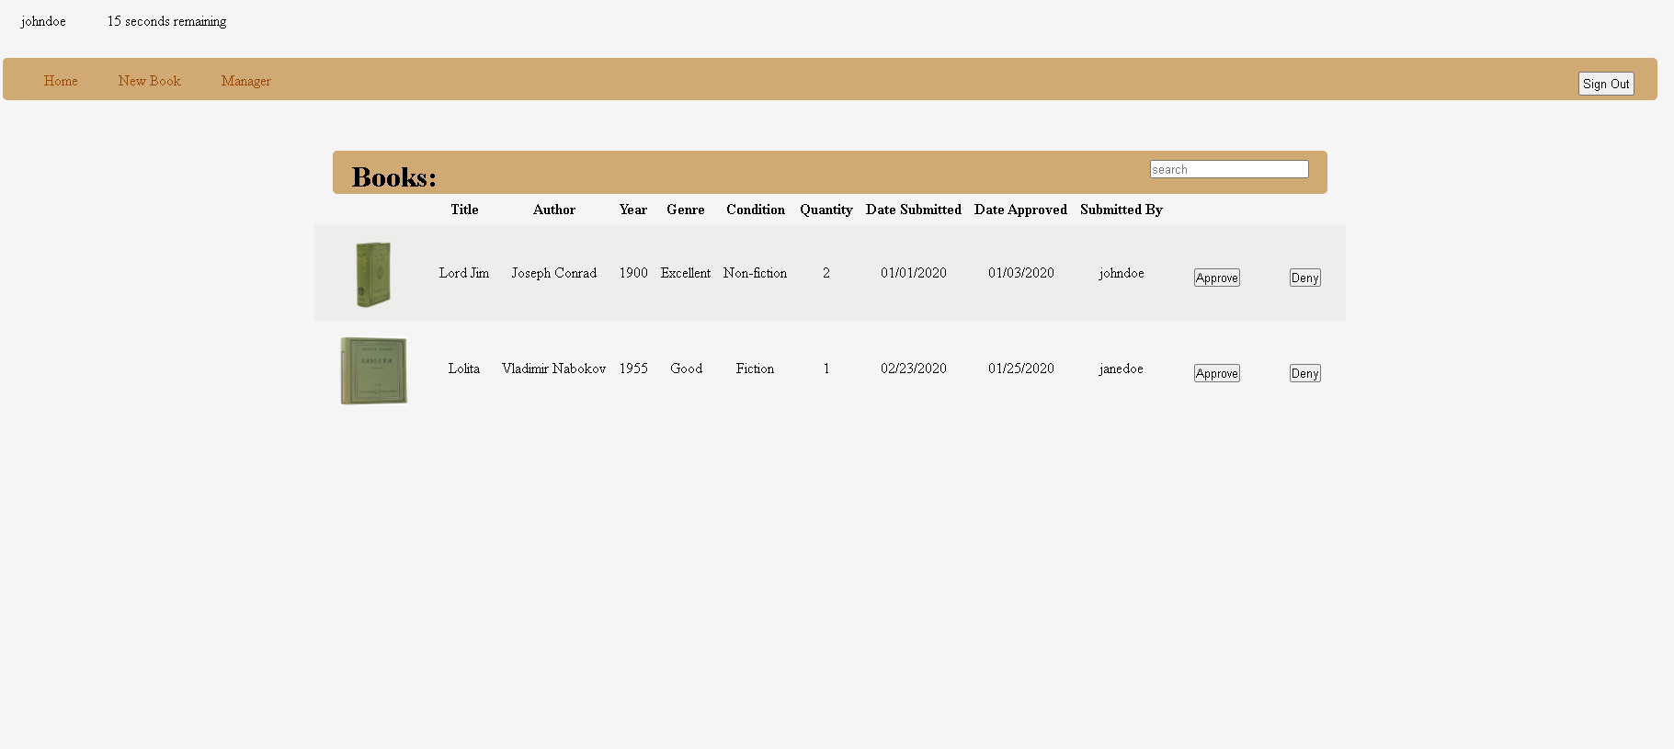
PROTOTYPE (manager)

Slide 12
Testing
Feedback:
Signing out timer should be the signout button
Manager table will also include a manager menu because it needs to track everything
Track add, delete, and update
Create username and temp password for employees
Hidden table with books that have a quantity of 0s
Updating should have its own page like adding books
Lack cohesiveness
Need a way to reset the password

